Slide 1
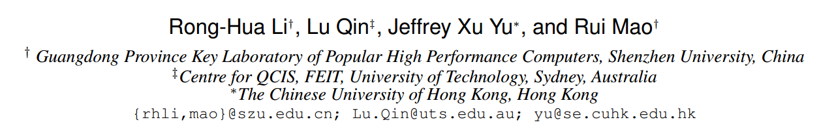
Efficient and Progressive Group Steiner Tree Search
SIGMOD-2016
TianzhuWei
2016/10/??

Slide 2
Contents
Problem definition
Exist Solution
Our Solution
Experiments
Thinking

Slide 3
The GST Problem
1
1
Given a weighted and labelled ( S ) graph G ;
A subset of labels P ( P ⊆ S ) ;
4
4
4
4
4
4
1
1
1
1
Find the minimum weight connected tree from G that includes all the labels in P
v1
v2
v3
v4
Notes:
边加权 ST 问题
每一个结点都有含有多个标签
给定一个查询标签集合P

Slide 4
Exist Solution
The parameterized DP algorithm
v
T(v,X)
The optimal weight of the state (v , X ) could be obtained by :
u
T(u,X)
a ) Edge growing operation
V
T(v,X)
X
b ) Tree merging operation
X
X = X₁ ∪ X₂
T(v,X₁)
v
v
T(v,X₂)
X₁
X₂
Notes:
state (v , X ) 表示以 v 为根，含有标签集合 X 的树

Slide 5
优先队列
按照入队子树的权重和进行排列，权重越小，优先值越高
1
v9
1
v7
v8
v1
v2
v3
v4
4
4
4
4
4
4
初始情况下将含有标签的结点看成是一个单个结点的树，权重为 0
v5
v6
1
1
1
1
v3
v4
v1
v2
v3
v4
v5
v5
v6
v6
v7
v7
v8
v8
1
1
1
1
4
4
4
4
v1
v2
v3
v4
v1
v2
v3
v4
v5
缺点：First, the time complexity
Second,the algorithm only generates a solution when it terminates
1
4
v1
v2

Slide 6


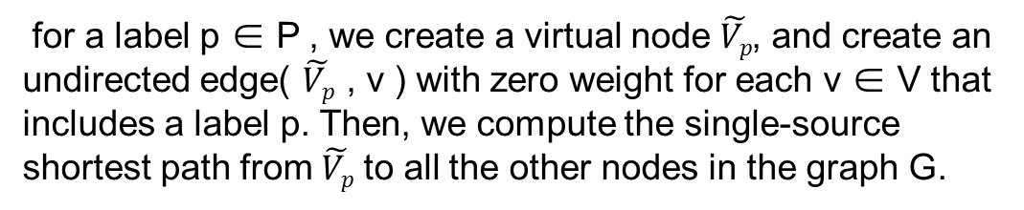



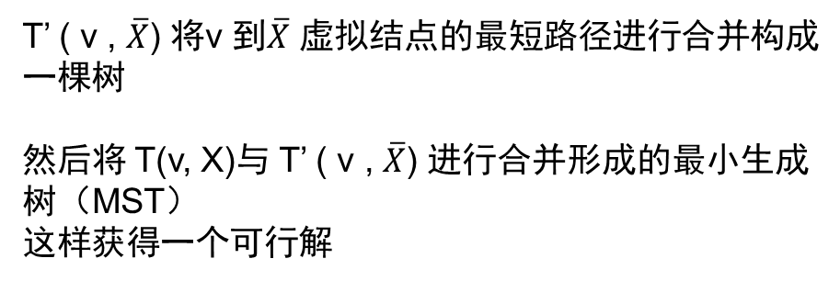
1
v9
1
The Basic algorithm
v7
v8
Preprocessing
4
4
4
4
4
4
for a label p ∈ P , we create a virtual node $\tilde{Vp}$, and create an undirected edge( $\tilde{Vp}$ , v ) with zero weight for each v ∈ V that includes a label p. Then, we compute the single-source shortest path from $\tilde{Vp}$ to all the other nodes in the graph G.
v5
v6
1
1
1
1
v1
v2
v3
v4
使用 Dijkstra 方法求解 $\tilde{Vp}$ 到其它 V 结点的最短路径
$$\overline{X}= P\backslash X$$
$\tilde{Vp}$1
$\tilde{Vp}$2
$\tilde{Vp}$4
T’ ( v , $\overline{X}$) 将v 到$\overline{X}$ 虚拟结点的最短路径进行合并构成一棵树
然后将 T(v, X)与 T’ ( v , $\overline{X}$) 进行合并形成的最小生成树（MST）
这样获得一个可行解
$\tilde{Vp}$3

Slide 7
The PrunedDP algorithm
u
Optimal-Tree Decomposition Theorem
Assume that each edge in the graph G has a positive weight. Then, for the optimal tree T∗ (P ), there always exists a node u ∈ T ∗ (P ) such that (i) the tree T∗ (P ) rooted at u has k (k ≥ 1) subtrees T1; T2; · · · ; Tk, and (ii) each subtree Ti (for i ∈ {1; 2; · · · ; k}) has a weight smaller than f∗ (P )=2.
v1
v2
……
vk
T1
T2
T3
THEOREM 2. Conditional Tree Merging Theorem: Without loss of optimality, to expand a state (v; X ) by a tree merging operation in the best-first DP algorithm, we can merge two subtrees T (v; X ) and T (v; X ′ ) for X ′ ⊂ P \X only when the total weight of these two subtrees is no larger than 2=3 × f ∗ (P ).
u
v1
v2
v3
w1
w2
w3
T1
T2
T3

Slide 8
THE PROGRESSIVE A* ALGORITHM
The PrunedDP++ algorithm

Slide 10
1
1
4
4
1
1
1
1
v1
v2
v3
v4

Slide 11
Thanks

